Slide 1

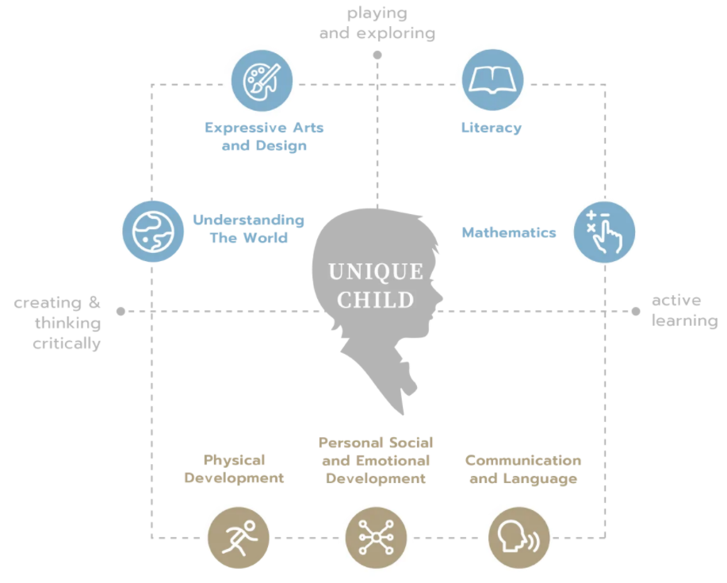
Reception Long
Term Plan 21-22
“At Crowle we are caring, confident and committed. we aim to ‘Make Learning Irresistible’. This runs through everything we do, from lessons, our learning environment both indoors and outdoors to visits and visitors. Our school is an amazing place to be and the staff and children are all very proud to be part of the Crowle community.
“Children feel valued and loved in school and staff pride themselves on building strong relationships with both parents/carers and children. We treat every child as an individual and are committed to the development of the ‘whole child’. We want children to enter KS1 happy, self-assured, independent learners with a thirst to learn and the confidence to know that they can do anything they want to do and that we will support them on their journey”
The EYFS Team at Crowle.

Slide 2





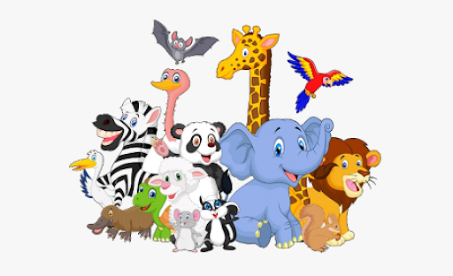
Reception Long Term Plan 21-22
 | Autumn 1 | Autumn 2 | Spring 1 | Spring 2 | Summer 1 | Summer 2
General Themes NB:These will be adapted depending on our cohort priorities and children’s interests. to introduce and discuss the question and the children’s responses to lead the learning journey. | I wonder what makes me special? Starting school / my new class / New Beginnings / all about me and my body / senses/ Careers My family / friendships/ PSED focus /relationships/feelings What am I good at? | I wonder who helps us? People who help us/ everyday superheroes and character superheroes Staying fit and healthy | I wonder how we travel and where we go? Places / Transport & Travel/ Space/ Journeys / Pirates | I wonder where people live? Houses and homes/ environments / cultures / Supporting the local community | I wonder why we love animals? Minibeasts / animals / Habitats/ protecting our environment | I wonder when was once upon a time? Magic / Castles / Fairytales / Transition
High quality Texts Hooked on Books Not and exhaustive list: Follow High quality texts from Reception reading list | Ruby’s Worry On Sudden Hill Rainbow Fish You Choose Goodnight Moon Here we are Funnybones Your Fantastic Brain Can I build another me? | Sam and Dave Dig a Hole How to Make a Chocolate Cake (healthy eating) On the Way Home Owl Babies Frog is a Hero Scardey Squirrel Six Dinner Sid Supertato | We’re Going on a Bear Hunt Mr Gumpy’s Outing Mrs Armitage The Naughty Bus Whatever Next Pirate Pete Journey The Grumpalump | Perfectly Norman Pigs Might Fly Handa’s Surprise The Name Jar Hello World One Day So Many Ways A New Home for a Pirate The House that Jack Built Iggy Peck Architect | Penguins I Wanna Iguana If Sharks Dissapeared The Most Magnificent Thing – STEM making for an animal How Many Legs Eric Carle stories Picture books - The Lion and the Mouse/ Tuesday/ Flotsam | Jack and the Jelly Bean Stalk Shh! The Kiss that Missed The Queens Knickers Growing/ Changing Transitioning to Y1 - The Growing Story Titch
Role play | Home Corner | Doctors/ Jolly Christmas Postman | Boxes (whatever next)/ Pirate Ship/ Chinese Cafe | Building site | Vets/ Zoo | Castle
‘Wow’ moments / Enrichment | Visit to the church 23rd Sept Family Friday 1st Oct Diwali Day 15th October Visit to Smite Farm 15th Oct Links to Harvest - Texts: Rosie’s walk, Little Red Hen, Farmer Duck First Aid Day 11th Sept National Fitness Day 22nd Sept World Smile Day 1st Oct Grandparents Day 4th Oct National Poetry Day7th October | Visit from difference occupations Family Friday 3rd Nov Trip to Smart Trees 7th Dec Remembrance day 11th Nov Christmas Time / Nativity/Santa | Train/ boat trip Valentines day 14th Feb Chinese New Year 1st Feb Family Friday 7th Jan & 4th Feb National Storytelling week 30th Jan-6th Feb Safer Internet Day 8th Feb Random acts of Kindness Day 17th Feb National Handwriting Day 23rd January | Walk around village Family Friday 4th March/ 1st April Mother’s Day 27th March World Book Day 3rd March Lent 2nd March Easter – We’re Going on an Egg Hunt Ramadan 2nd April World Book Day 4th March | Visit from an animal expert Caterpillars in Frogspawn in classroom or pond visits Family Friday 6th May | Castle visit Family Friday 10th June & 1st July Sports Day 15th July Whole School Trip 18th July World Ocean Day 8th June Fathers Day 20th June

Slide 3
Reception Long Term Plan 21-22
 |  | Autumn 1 | Autumn 2 | Spring 1 | Spring 2 | Summer 1 | Summer 2
General Themes |  | I wonder what makes me special? | I wonder who helps us? | I wonder how we travel and where we go? | I wonder where people live? | I wonder why we love animals? | I wonder when was once upon a time?
Key vocabulary Not an exhaustive list as vocabulary will be explained and practiced as it appears in conversation or through texts. | Tier 1 | Names of basic body parts, face, hands, feet, elbow, etc Special, family, friends (friendship), like, same /different family names (mum, dad, grandparent, auntie ect) Daily routines and school specific vocab (book bag, area ect) | Names of people, basic things associated with jobs Fire, ambulance, etc. Save, safe, help, hero, super, | Names of vehicles and places Map, holiday, visit, road, sea, sky | House, home, bathroom, stairs, (familiar house words), build, builder, | Names of animals and basic descriptions of habitats, mud, tree, grass, pond Pets, zoo, | Story and character vocabulary, magic, giant, castle, knight, princess, queen, king, old, new
 | Tier 2 | unique, dislike, similarities/ differences, function, purpose, siblings, kin, thankful, talent, ability, | occupation, rescue, emergency, urgent, healthy, exercise (fit), trust, danger, dangerous, lifestyle, diet, stretch, balance, minerals, vitamins, medicine, prescription, Specific names for tools that go with jobs (stethoscope, handcuffs etc) Nativity vocab | Transport, travel, route, journey, adventure, plan, atlas, globe, agent, flight, perseverance, island, space astronaut Transport specific vocab (carriage, turntable, sails ect) Pirate specific vocab (doubloons, treasure, binoculars) | Street, lighthouse, manor, farm, bungalow, flat/apartment, detached, semi-detached, terraced, village, hamlet, city, countryside, tradition, culture, community, layout, language, design, create, costume Names of places/countries Forgiveness Easter Vocab/ lent, risen, sacrifice | Environments, protect, recycle, ocean, dessert, forest, canopy, woodland, farm, agriculture, livestock, mammals, reptiles, amphibians, carnivore, herbivore, Vet role play vocabulary (medical vocab) Minibeasts, thorax, antenna ect. | Villain, culprit, Story starters, a long time ago, once upon a time, one gloomy day……. Specific castle language (role play) dungeon, arrow, types of castles, drawbridge, Portcullis ….. Traditional, fairy-tale, Imagine, Respect Transition, change, prepare, grow, Past, present, future Plot, problem, ending, beginning, wicked, charming, handsome, brave, fearless, heroine,
 | Tier 3 | extraordinary, compare, precious, passion, | Mindfulness, ambition, | Expedition, explorer, discover, | Urban, rural, landscape, architect | Conservation, global warming, | Enchanting, resolution,

Slide 4

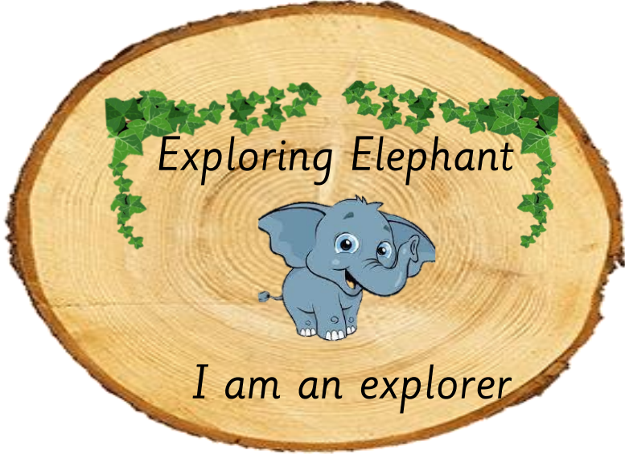
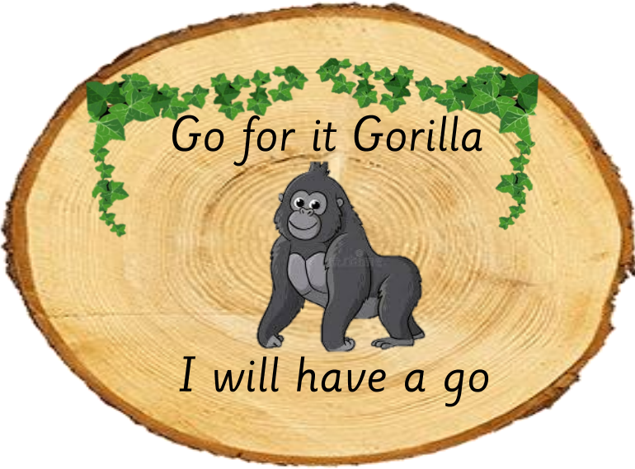
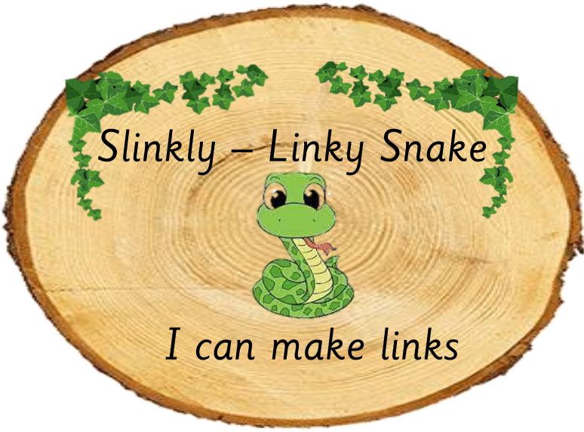
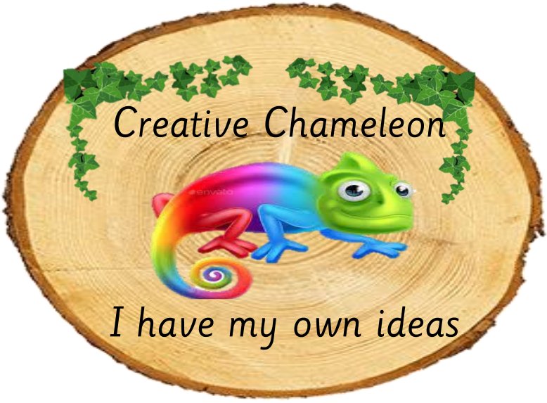
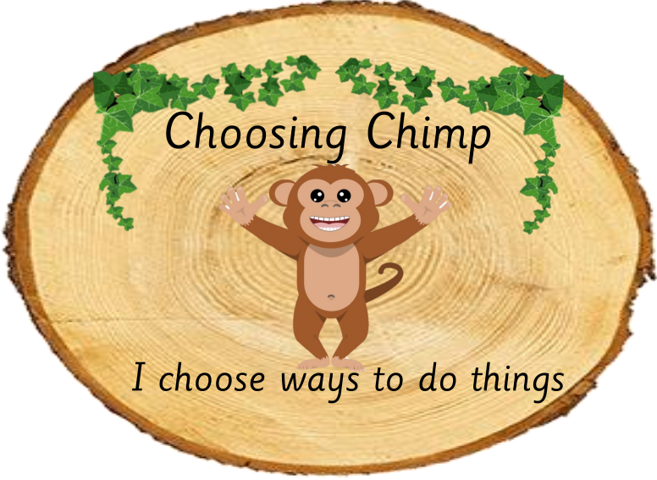
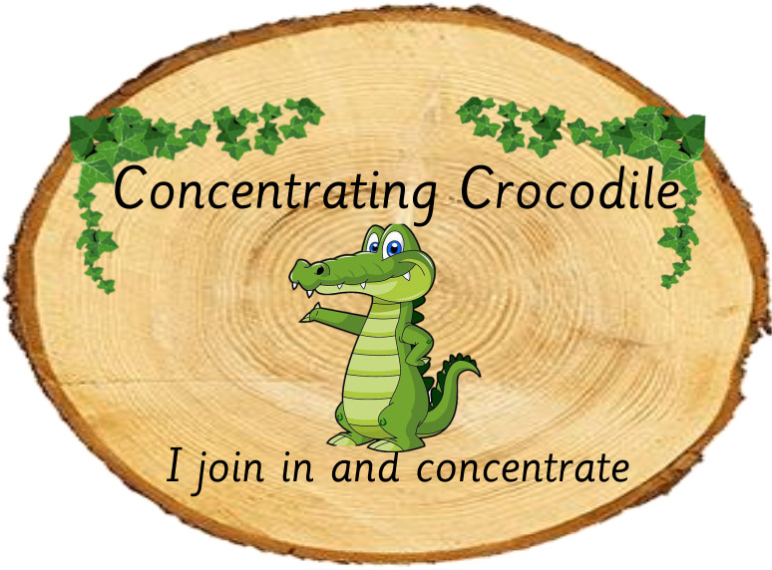
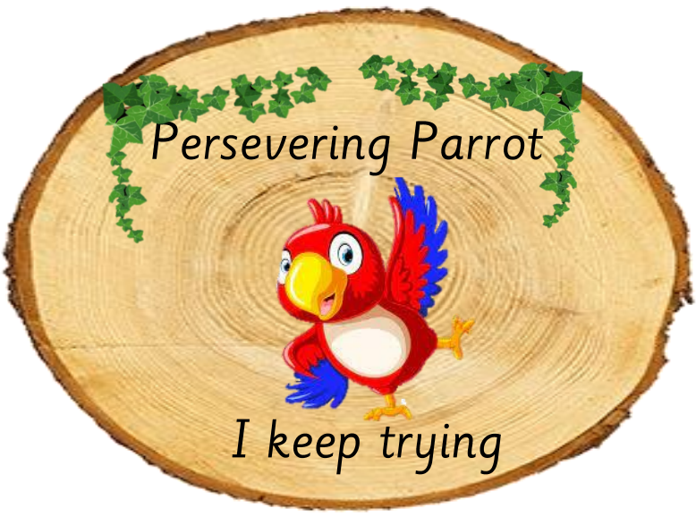
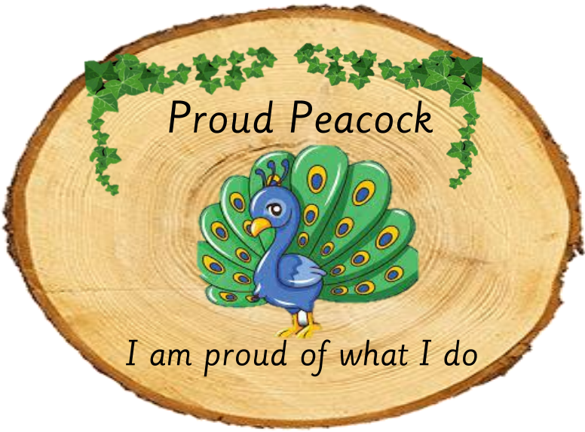
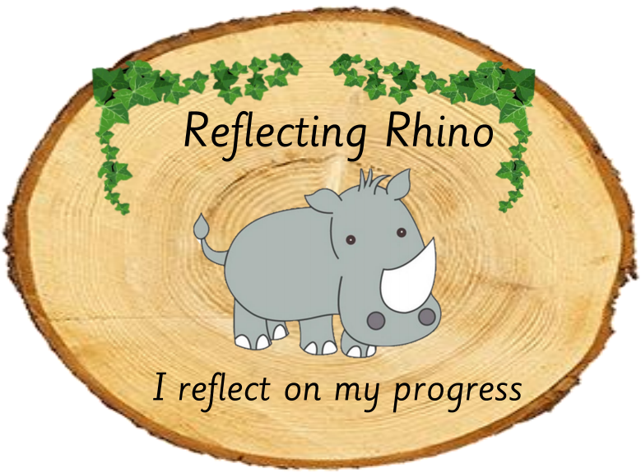
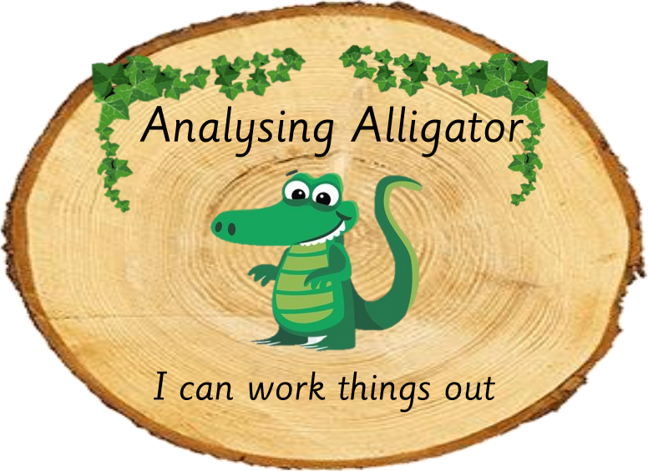
Reception Long Term Plan 21-22
 | Autumn 1 | Autumn 2 | Spring 1 | Spring 2 | Summer 1 | Summer 2
General Themes | I wonder what makes me special? | I wonder who helps us? | I wonder how we travel and where we go? | I wonder where people live? | I wonder why we love animals? | I wonder when was once upon a time?
Over Arching Principles | Characteristics of Effective Learning Playing and exploring: - Children investigate and experience things, and ‘have a go’. Children who actively participate in their own play develop a larger store of information and experiences to draw on which positively supports their learning Active learning: - Children concentrate and keep on trying if they encounter difficulties. They are proud of their own achievements. For children to develop into self-regulating, lifelong learners they are required to take ownership, accept challenges and learn persistence. Creating and thinking critically: - Children develop their own ideas and make links between these ideas. They think flexibly and rationally, drawing on previous experiences which help them to solve problems and reach conclusions.
Over Arching Principles | Unique Child: Every child is unique and has the potential to be resilient, capable, confident and self-assured. Positive Relationships: Children flourish with warm, strong & positive partnerships between all staff and parents/carers. This promotes independence across the EYFS curriculum. Children and practitioners are NOT alone – embrace each community. Enabling environments: Children learn and develop well in safe and secure environments where routines are established and where adults respond to their individual needs and passions and help them to build upon their learning over time. Learning and Development: Children develop and learn at different rates (not in different ways as it stated 2017). We must be aware of children who need greater support than others. PLAY: At Crowle, we understand that children learn best when they are absorbed, interested and active. We understand that active learning involves other children, adults, objects, ideas, stimuli and events that aim to engage and involve children for sustained periods. PLAY is essential for children’s development across all areas. Play builds on children’s confidence as they learn to explore, to relate to others around them and develop relationships , set their own goals and solve problems. Children learn by leading their own play and by taking part in play which is guided by adults. We will ensure that all children learn and develop well and are kept healthy and safe at ALL times.
COEL

Slide 5
Reception Long Term Plan 21-22
 | Autumn 1 | Autumn 2 | Spring 1 | Spring 2 | Summer 1 | Summer 2
General Themes | I wonder what makes me special? | I wonder who helps us? | I wonder how we travel and where we go? | I wonder where people live? | I wonder why we love animals? | I wonder when was once upon a time?
Our Crowle values Routed in the Christian ethos of the school | Year 1 Thankfulness Christians believe that God loves and cares for them in many different ways in all aspects of their life. They know that their response to this provision should be one of thankfulness and praise. Year 2 Generosity God’s generosity is best described as ‘grace’, love given freely without limit or conditions. This generosity once experienced unacknowledged by an individual, can in turn release a generous spirit towards others . | Year 1 Trust Trust is the basis of all stable relationships, including a person’s relationship with God. It is rooted in truth and will grow through consistent experiences of reliability and integrity. God’s commitment to humanity is seen in his willingness to trust ordinary people with the carrying out of his purposes through history. Year 2 Compassion Christians believe that their attitudes and actions must reflect the kindness, mercy and compassion of Jesus and the love of God for everyone. | Year 1 Perseverance Jesus frequently encouraged his disciples to ‘endure patiently’ the difficulties and obstacles they encountered and to persevere in the face of adversity. He himself trusted God even when his enemies tried to stop his work and plotted his death. Year 2 Courage Basic to Christian faith is the claim that God is always present in every situation. This belief has led to great acts of courage that have included facing danger and opposition, overcoming fear, making a stand for what is right and encouraging others to persevere. Through prayer people have found the strength to help them to be courageous. | Year 1 Forgiveness Forgiveness is the means by which damaged relationships are restored. It is an act of will, motivated by love. For Christians, Jesus’ death on a cross is the ultimate revelation of gods or for giving love, and his sacrifice stands as a source of inspiration to forgive others, no matter what the cost. Year 2 Justice The justice revealed in the Bible is always seen in the context of love. It includes the core to take responsibility for one another, especially the poor and oppressed, and to see that no one is excluded from the essentials of life. | Year 1 Friendship Christians believe they can call God their friend because of the relationship made possible through Jesus. Year 2 Service Jesus exemplified in his person, ministry and relationship to God, what it was to be called the ‘servant king’. Christians believe that their calling is to follow Jesus’ is example according to their gifts or abilities. They believe that through serving God in others, ‘perfect freedom’ will ultimately be found. | Year 1 Respect The nature of God, as revealed in the Bible, presents all people with a choice. Those whose response is one of respect are acknowledging God’s greatness, authority and involvement in the world. This will extend to respect for the created order, including humanity made in the image of God. Year 2 Truthfulness Christians believe that truth is revealed in the Bible and supremely in the person and life of Jesus Christ. Through Jesus is teaching we are given an insight into the nature of God and the way in which he means us to live.
Core Principles | Caring Confident committed Our school prioritises relationships. We really care for each other as a staff team, for our children and our families. Crowle is a lovely place to be. Our values are not just laminated on classroom walls, they permeate through everything we do and our behaviours as a team. You feel the ethos of our school the second you walk through the door. We prioritise the inner curriculum as much as the more easily recognisable outer curriculum. We want our children to leave us with academic intelligence, emotional intelligence and ethical intelligence.

Slide 6
Reception Long Term Plan 21-22
 | Autumn 1 | Autumn 2 | Spring 1 | Spring 2 | Summer 1 | Summer 2
General Themes | I wonder what makes me special? | I wonder who helps us? | I wonder how we travel and where we go? | I wonder where people live? | I wonder why we love animals? | I wonder when was once upon a time?
British Values Sharing Circles | Mutual respect We are all unique. We respect differences between different people and their beliefs in our community, in this country and all around the world. All cultures are learned , respected, and celebrated. | Mutual Tolerance Everyone is valued, all cultures are celebrated, and we all share and respect the opinions of others. Mutual tolerance of those with different faiths and beliefs and for those without faith. Done through celebrations | Rule of law We all know that we have rules at school that we must follow. We know who to talk to if we do not feel safe. We know right from wrong. We recognise that we are accountable for our actions. We must work together as a team when it is necessary. Class rules | Individual liberty We all have the right to have our own views. We are all respected as individuals. We feel safe to have a go at new activities. We understand and celebrate the fact that everyone is different. | Democracy We all have the right to be listened to. We respect everyone and we value their different ideas and opinions. We have the opportunity to play with who we want to play with. We listen with intrigue and value and respect the opinions of others. | Recap all British Values Fundamental British Values underpin what it is to be a citizen in a modern and diverse Great Britain valuing our community and celebrating diversity of the UK. Fundamental British Values are not exclusive to being British and are shared by other democratic countries.
Assessment opportunities | In-house - Baseline data on entry National Baseline data Awareness of checkpoints using Development matters as a scaffold alongside teacher judgement. On-going | On going assessments Pupil progress meetings Parents evening info In house moderation End of term Assessments Phonics assessments Key word assessments | Projections for EOY On going assessments Pupil progress meetings | Pupil progress meetings Parents evening info End of term Assessments Phonics assessments Key word assessments On going assessments | On going assessments Pupil progress meetings | Pupil progress meetings Reports Phonics assessments Key word assessments EOY data
Parental Involvement | Welcome meeting Family Friday Phonics Meeting | Family Friday Nativity Parents Evening Focussed child meetings | Family Friday Valentines day lunch Focussed child meetings | Family Friday Parents Evening Easter celebrations Focussed child meetings | Family Friday Focussed child meetings | Family Friday Parents Evening Family Fairytale Picnic

Slide 7
Diversity Texts to be read throughout the year during story time sessions
BAME main characters | Cultural diversity | Neurodiversity | physical disabilities | Different families
So much Astro Girl Lulu’s first day Baby goes to market Mommy saying Full, full full of love 15 things not to do with a puppy Jabari jumps Izzy gizmo Little people big dreams books | The big book of families Maisie’s scrapbook Hats of faith The jasmine sneeze Golden domes and silver lanterns | We’re all wonders Incredible you I see things differently Mr Gorski I think I have the wiggle fidgets Because What makes me a me? The unbudgable curmudgeon | Its ok to be different When Charlie met emma Only one you Don’t call me special Happy to be me Millie gets her super ears | My pirate mums Mt two grandads The girl with two dads We are family More people to love me Our class is a family Love makes a family Heather has two mummies

Slide 8

Reception Long Term Plan 21-22
 |  | Autumn 1 | Autumn 2 | Spring 1 | Spring 2 | Summer 1 | Summer 2
General Themes |  | I wonder what makes me special? | I wonder who helps us? | I wonder how we travel and where we go? | I wonder where people live? | I wonder why we love animals? | I wonder when was once upon a time?
Communication and Language Know the home language of children in your cohort. Learn a few key words and celebrate multilingualism in your setting. |  | The development of children’s spoken language underpins all seven areas of learning and development. Children’s back-and-forth interactions from an early age form the foundations for language and cognitive development. The number and quality of the conversations they have with adults and peers throughout the day in a language-rich environment is crucial. By commenting on what children are interested in or doing, and echoing back what they say with new vocabulary added, practitioners will build children's language effectively. Reading frequently to children, and engaging them actively in stories, non-fiction, rhymes and poems, and then providing them with extensive opportunities to use and embed new words in a range of contexts, will give children the opportunity to thrive. Through conversation, story-telling and role play, where children share their ideas with support and modelling from their teacher, and sensitive questioning that invites them to elaborate, children become comfortable using a rich range of vocabulary and language structures.
Whole EYFS Focus – C&L is developed throughout the year through high quality interactions, daily group discussions, sharing circles, PSHE times, stories, singing, speech and language interventions, Word wall and area to explore new vocab in context. | Skills | To talk about themselves & others . Uses simple sentences to communicate their needs. To begin using some active listening skills ; Faced the speaker, body still, paying attention. To you sing songs & rhymes. To speak about the stories they enjoy, joining in with familiar, repetitive phrases. To begin making stories, talking in sentences (Helicopter Stories) To listen to & follow one/two step instructions | To talk about their experiences. To talk aloud their ideas during play. To make comments about their observations. To ask simple questions. To listen to others. To talk about daily routines and follow instructions. To talk about Their preferences. To join in whole class group & individual discussions | To listen to others & respond appropriately. To take turns to talk. To talk about their feelings & to begin explaining their choices. To show attentive listening skills at input times. To speak in whole class situations . To use nearly learned vocabulary in different contexts . To ask questions to find out more. Uses talk to organise simple activities . | To offer small explanations that demonstrate their understanding on a topic or story. To ask & answer questions to deepen their understanding. To use recently modelled language in dependently across everyday contexts. To use a range of connectives to extend their sentences & connect their ideas . Use more detailed conversation Uses speech to overcome problems/ conflicts & to provide explanations. | To speak with awareness of the audience. To listen attentively and respond with relevant questions and comments To participate in small group class and one to one discussions, offering their own ideas, using recently introduced vocabulary. To show awareness of past present and future tenses modelled & supported by an adult. | To hold a conversation with back & forth exchanges. To make comments, asking questions & giving explanations. To use a wide range of vocabulary & intonation to communicate their ideas & express their opinions. To use some past present & future tenses correctly.
 | Knowledge | To know about others. To know familiar songs & stories. To know how to initiate a conversation with others. | To know how to respond to a peers request. To know how different people help us. To know how to use some new vocabulary in context. To know a range of ways to stay healthy. | To know the link between listening & learning/ understanding. To describe & compare different forms of transport and travel | Do you know where people live & talk about life in different cultures & communities. To know That language & communication is different across our world. To begin to know about different features of texts. | To know how to engage in meaningful conversations with others . To know how to use facts to talk about animals. | To know how to use a ‘story voice’, adding some expression when re-telling.

Slide 9

Reception Long Term Plan 21-22
 | Autumn 1 | Autumn 2 | Spring 1 | Spring 2 | Summer 1 | Summer 2
General Themes | I wonder what makes me special? | I wonder who helps us? | I wonder how we travel and where we go? | I wonder where people live? | I wonder why we love animals? | I wonder when was once upon a time?
Personal, Social and Emotional Development | Children’s personal, social and emotional development (PSED) is crucial for children to lead healthy and happy lives, and is fundamental to their cognitive development. Underpinning their personal development are the important attachments that shape their social world. Strong, warm and supportive relationships with adults enable children to learn how to understand their own feelings and those of others. Children should be supported to manage emotions, develop a positive sense of self, set themselves simple goals, have confidence in their own abilities, to persist and wait for what they want and direct attention as necessary. Through adult modelling and guidance, they will learn how to look after their bodies, including healthy eating, and manage personal needs independently. Through supported interaction with other children, they learn how to make good friendships, co-operate and resolve conflicts peaceably. These attributes will provide a secure platform from which children can achieve at school and in later life.
Managing Self Self regulation Making relationships | SCARF: Me and My Relationships All about me What makes me special Me and my special people Who can help me? (self-regulation) Me and my feelings 1 & 2 (naming different feelings, thinking about how to feel with ‘not so good feelings’, know some self-care techniques) Know that some actions and words can hurt others feelings. Handwashing Class rules: Behavioural expectations in the class/boundaries set Class rules | SCARF: Keeping myself safe What’s safe to go in my body? Keeping myself safe Safe indoors and outdoors Listening to my feelings Keeping safe online People who help to keep me safe Oral hygiene: teeth cleaning linked to the dental nurse Staying safe and dangers linked to people who help us and staying healthy | SCARF: Being my best Bouncing back when things go wrong: resilience Yes I can: confidence and resilience Healthy eating (2 weeks) Move your body A good nights sleep Journeys – perseverance and resilience | SCARF: Valuing Difference I’m special you’re special Same and different Same and different families Same and different homes I am caring Kind and caring I know what it means to be respectful and to be treated with respect | SCARF: Rights and responsibilities Looking after my special people: I know that caring relationships are at the heart of happy families Looking after my friends: I know what makes a good friend Being helpful at home and caring for our classroom Caring for our world Looking after money Looking after money (2) Linked with caring for animals, environment and the community | SCARF: Growing and changing Seasons Life stages, plants, animals, humans Life stages, human life stage, who will I be? Where do babies come from? Getting bigger Me and my body, girls and boys Transition into Year 1 Year 1 readiness
Self - Regulation Link to Behaviour for Learning | * Controlling own feelings and behaviours *Applying personalised strategies to return to a state of calm *Being able to curb impulsive behaviours *Being able to concentrate on a task *Being able to ignore distractions *Behaving in ways that are pro-social *Planning *Thinking before acting *Delaying gratification * Persisting in the face of difficulty.

Slide 10

Reception Long Term Plan 21-22
 | Autumn 1 | Autumn 2 | Spring 1 | Spring 2 | Summer 1 | Summer 2
General Themes | I wonder what makes me special? | I wonder who helps us? | I wonder how we travel and where we go? | I wonder where people live? | I wonder why we love animals? | I wonder when was once upon a time?
Physical development Fine motor Continuously check the process of children’s handwriting (pencil grip and letter formation, including directionality). Provide extra help and guidance when needed. Gross motor Daily Squiggle whilst you wiggle | Physical activity is vital in children’s all-round development, enabling them to pursue happy, healthy and active lives. Gross and fine motor experiences develop incrementally throughout early childhood, starting with sensory explorations and the development of a child’s strength, co-ordination and positional awareness through tummy time, crawling and play movement with both objects and adults. By creating games and providing opportunities for play both indoors and outdoors, adults can support children to develop their core strength, stability, balance, spatial awareness, co-ordination and agility. Gross motor skills provide the foundation for developing healthy bodies and social and emotional well-being. Fine motor control and precision helps with hand-eye co-ordination, which is later linked to early literacy. Repeated and varied opportunities to explore and play with small world activities, puzzles, arts and crafts and the practice of using small tools, with feedback and support from adults, allow children to develop proficiency, control and confidence.
Fine motor | Fine motor provision available everyday. The provision should be monitored, and resources changed to meet the progression needs of the children offering challenge and support. Skills to practice will include tripod grip tools for building strength and dexterity (pipettes, tongs, spinners etc.) Threading/ Weaving Scissors Hammers, pegs, nuts and bolts, screws Block play, lego Playdough A variety of pens, paintbrushes, sponges and mark making equipment
 | Dough Disco | Dough Disco. Develop muscle tone to put pencil pressure on paper Use tools to effect changes to materials Show preference for dominant hand Engage children in structured activities: guide them in what to draw, write or copy. | Handle tools, objects, construction and malleable materials with increasing control Encourage children to draw freely. | Hold pencil effectively with comfortable grip Forming recognizable letters | Develop pencil grip and letter formation continually Use one hand consistently for fine motor tasks Cut along a straight line with scissors / Start to cut along a curved line, like a circle. | . Form letters correctly Cut a shape out using scissors Begin to draw diagonal lines, like in a triangle / Start to colour inside the lines of a picture Draw pictures that are recognisable
Gross motor | Forest Schools – see separate plans To climb and land safely on outdoor equipment | Forest Schools – see separate plans To climb, balance and land safely on outdoor equipment | Forest Schools – see separate plans To climb, balance and travel in different ways, landing safely on outdoor equipment. | Forest Schools – see separate plans To climb, travel, balance and keep safe on equipment without hesitation. | Forest Schools – see separate plans | Forest Schools – see separate plans
 | CONTINUOUS PROVISION; Cooperation games i.e. parachute games, Climbing – outdoor equipment., Help individual children to develop good personal hygiene, . Provide regular reminders about thorough handwashing and toileting. Crates play- climbing, Provide a range of wheeled resources for children to balance, sit or ride on, or pull and push. Two-wheeled balance bikes and, skateboards, wheelbarrows, prams and carts are all good options

Slide 11

Reception Long Term Plan 21-22
 |  | Autumn 1 | Autumn 2 | Spring 1 | Spring 2 | Summer 1 | Summer 2
General Themes |  | I wonder what makes me special? | I wonder who helps us? | I wonder how we travel and where we go? | I wonder where people live? | I wonder why we love animals? | I wonder when was once upon a time?
Literacy Comprehension - Developing a passion for reading Children will visit the library weekly | Skills | It is crucial for children to develop a life-long love of reading. Reading consists of two dimensions: language comprehension and word reading. Language comprehension (necessary for both reading and writing) starts from birth. It only develops when adults talk with children about the world around them and the books (stories and non-fiction) they read with them, and enjoy rhymes, poems and songs together. Skilled word reading, taught later, involves both the speedy working out of the pronunciation of unfamiliar printed words (decoding) and the speedy recognition of familiar printed words. Writing involves transcription (spelling and handwriting) and composition (articulating ideas and structuring them in speech, before writing)
Literacy Comprehension |  | I can show a preference for a book, song or rhyme. Listens to familiar stories and able to recall some facts. | I can talk about events and characters in a story read to me. I can join in with rhymes and stories. I can fill in missing words from well-known rhymes | I can show interest and answer simple questions about the text I use words that I know to check my reading makes sense Listens to stories and is beginning to anticipate what may happen next. | I can demonstrate understanding when talking about what I have read I can repeat words or phrases to check my reading | I am beginning to notice if my reading makes sense and looks right I think about what I already know to help me with my reading I can sometimes notice errors I know that illustrations can help me make sense of my reading | I can demonstrate understanding of what has been read to me by retelling stories & narratives using my own words & recently introduced vocabulary (ELG) I can use & understand recently introduced vocabulary during discussions about stories, non-fiction, rhymes & poems and during role-play (ELG)
Word Reading | Knowledge | To know words can be written. Knows how to sequence familiar stories. | Knows how to sequence familiar stories. | To know that a sentence starts with a capital letter and ends with a full stop. | To know that a sentence starts with a capital letter and ends with a full stop. | Knows how to use learnt words and phrases to discuss familiar stories or during role play.

Slide 12
Reception Long Term Plan 21-22
 |  | Autumn 1 | Autumn 2 | Spring 1 | Spring 2 | Summer 1 | Summer 2
General Themes |  | I wonder what makes me special? | I wonder who helps us? | I wonder how we travel and where we go? | I wonder where people live? | I wonder why we love animals? | I wonder when was once upon a time?
Literacy Word Reading Children will be working in different groups for Read Write Inc. SH – Focus on consolidation of set 1 sounds and Set 2 Sounds, Green words . Ditty sheets, introduction of Red Ditty Books and Purple books for more confident readers. | Skills | It is crucial for children to develop a life-long love of reading. Reading consists of two dimensions: language comprehension and word reading. Language comprehension (necessary for both reading and writing) starts from birth. It only develops when adults talk with children about the world around them and the books (stories and non-fiction) they read with them, and enjoy rhymes, poems and songs together. Skilled word reading, taught later, involves both the speedy working out of the pronunciation of unfamiliar printed words (decoding) and the speedy recognition of familiar printed words. Writing involves transcription (spelling and handwriting) and composition (articulating ideas and structuring them in speech, before writing)
Literacy Comprehension |  | Letters & Sounds Week 1 – Phase 1 activities satp inmd gock ckeur Tricky words to, the Hbfl ff,ll,ss Tricky Words no, go, I, into Week 8 - revision I can handle books correctly and follow print left to right, top to bottom I can locate the title I enjoy rhyming & alliteration Listening to and identifying sounds in the environments. Listening to and hearing initial sounds in familiar words. To identify sounds (grapheme/ phoneme correspondence) in the environment. | Letters & Sounds Jvwx yz,zz,qu we me (write: to the) Ch,sh, th, ng He she be ai,ee,igh,oa was (write: no go) oi,oo,oo,ow my Ar,air,ear you er,ur,or,ure Her they all are I can Link most sounds to letters I am beginning to blend and segment in order to read vc and cvc words I am beginning to match spoken word to written word | Letters & Sounds Revise phase 1, 2 & 3 I can read with 1-1 correspondence I can link all sounds to letters I can solve simple words by blending sounds and I check what I read makes sense and sounds right Listening to and hearing sounds in CVC and CVCC words. Identifying sounds on a sound mat. | Letters & Sounds Revision & Phase 4 I can read and understand simple sentences I can use phonic knowledge to read and decode regular words Listening to and hearing sounds in CVC and CVCC words. Identifying sounds, including phonemes and other digraphs on a sound mat. | Letters & Sounds Revision & Phase 4 I can say a sound for each letter in the alphabet and at least 10 digraphs (ELG) I can read words consistent with my phonic knowledge by sound blending (ELG) I can re-read books showing increased accuracy and fluency | Letters & Sounds Revision, consolidation and fluency End of term assessments Transition work with Year 1 staff
Word Reading | Knowledge | To know the sounds that the taught letters make. To know what the taught letters look like. | To begin recognising taught HFW in text. | Knowing the sounds that the taught phonemes make. Knowing what the taught phonemes look like. | Knowing the sounds that the taught phonemes make. Knowing what the taught phonemes look like. | Knowing the sounds that the taught phonemes make. Knowing what the taught phonemes look like. To know that a sentence starts with a capital letter and ends with a full stop. Knows how to spell some familiar words.

Slide 13
Reception Long Term Plan 21-22
 | Autumn 1 | Autumn 2 | Spring 1 | Spring 2 | Summer 1 | Summer 2
General Themes | I wonder what makes me special? | I wonder who helps us? | I wonder how we travel and where we go? | I wonder where people live? | I wonder why we love animals? | I wonder when was once upon a time?
Writing TFW used as stimulus across the year Texts may due t children’s interests | Multi-sensory writing and patterns. Dominant hand, tripod grip, mark making, giving meaning to marks and labelling. Name writing, Shopping lists, Writing initial sounds and simple captions. Use initial sounds to label characters / images. Silly soup. Names Labels. Writing for a purpose in role play PHASE WORDS | Recount, Name writing, emergent writing, labelling, story scribing. Retelling stories, letter writing , lists, recipies Writing tricky words PHASE WORDS | Exciting adjectives ‘Wow words’ Rhyming words/early sentences sentences Instructions Captions Writing recipes, lists. PHASE WORDS | Creating own story maps, writing captions and labels, writing simple sentences. Writing short sentences to accompany story maps. Labels and captions, Character descriptions. Order the Easter story PHASE WORDS | Writing for a purpose in role play using phonetically plausible attempts at words, beginning to use finger spaces. Form lower-case and capital letters correctly. Rhyming words. Riddles, fact books, poems | Story writing, writing sentences using a range of tricky words that are spelt correctly. Beginning to use full stops, capital letters and finger spaces. Innovation of familiar texts Using familiar texts as a model for writing own stories.
Skills | To begin writing letter shapes To write letter shapes to match the correct spoken sound | To use phonics to segment CVC words to spell | To write a phonetically plausible dictated sentence. (hold a sentence) | To think of and write a short, simple sentence. | To write a sentence with a connective and correctly spelt tricky words Checking written work and making any changes where necessary.
knowledge | Know how to write taught letters | Know how to write letter in sequence of the sounds heard in a word. | To spell some familiar words and write for a purpose. To write words with diagraphs |  | To know how to say and write a complete sentence with a capital letter and full stop.

Slide 14

Reception Long Term Plan 21-22
 | Autumn 1 | Autumn 2 | Spring 1 | Spring 2 | Summer 1 | Summer 2
General Themes | I wonder what makes me special? | I wonder who helps us? | I wonder how we travel and where we go? | I wonder where people live? | I wonder why we love animals? | I wonder when was once upon a time?
Maths “Without mathematics, there’s nothing you can do. Everything around you is mathematics. Everything around you is numbers.” – Shakuntala Devi | Developing a strong grounding in number is essential so that all children develop the necessary building blocks to excel mathematically. Children should be able to count confidently, develop a deep understanding of the numbers to 10, the relationships between them and the patterns within those numbers. By providing frequent and varied opportunities to build and apply this understanding - such as using manipulatives, including small pebbles and tens frames for organising counting - children will develop a secure base of knowledge and vocabulary from which mastery of mathematics is built. In addition, it is important that the curriculum includes rich opportunities for children to develop their spatial reasoning skills across all areas of mathematics including shape, space and measures. It is important that children develop positive attitudes and interests in mathematics, look for patterns and relationships, spot connections, ‘have a go’, talk to adults and peers about what they notice and not be afraid to make mistakes.
Maths | White Rose Maths baseline/getting to know you Matching Sorting Comparing amounts Compare size/mass/capacity Exploring patterns | White Rose Maths Representing and comparing 1,2,3 Composition of 1,2,3 Circles and triangles & Spatial awareness The number 4/ The number 5 One more one less Comparing shapes Night and day (routines/time) | White Rose Maths Zero and comparing numbers to 5 Composition of 4 and 5 Mass and capacity Learning about 6,7 and 8 Pairs and combining groups to 10 Length and height | White Rose Maths 9 and 10 Comparing numbers to 10 Number bonds to 10 (2 weeks) 3D shape Consolidation (respond to what they need more support with) | White Rose Maths Building numbers beyond 10 Counting patterns/spatial reasoning Adding more x2 weeks Taking away x2 weeks | Depth of numbers within 20 Explore numbers and strategies •Recognise and extend patterns •Apply number, shape and measures knowledge •Count forwards and backwards Numbers beyond 20 One more one less •Estimate and count •Grouping and sharing | White Rose Maths Doubles Sharing and grouping Odd and Even Spatial reasoning Deepening understanding x2 weeks Patterns Consolidation

Slide 15

Reception Long Term Plan 21-22
 |  | Autumn 1 | Autumn 2 | Spring 1 | Spring 2 | Summer 1 | Summer 2
General Themes |  | I wonder what makes me special? | I wonder who helps us? | I wonder how we travel and where we go? | I wonder where people live? | I wonder why we love animals? | I wonder when was once upon a time?
Understanding the world Past & Present People, culture & communities The natural world RE – Worcestershire Agreed Syllabus | Skills | Understanding the world involves guiding children to make sense of their physical world and their community. The frequency and range of children’s personal experiences increases their knowledge and sense of the world around them – from visiting parks, libraries and museums to meeting important members of society such as police officers, nurses and firefighters. In addition, listening to a broad selection of stories, non-fiction, rhymes and poems will foster their understanding of our culturally, socially, technologically and ecologically diverse world. As well as building important knowledge, this extends their familiarity with words that support understanding across domains. Enriching and widening children’s vocabulary will support later reading comprehension.
Understanding the world RE / Festivals Our RE Curriculum enables children to develop a positive sense of themselves and others and learn how to form positive and respectful relationships. They will begin to understand and value the differences of individuals and groups within their own community. Children will have opportunity to develop their emerging moral and cultural awareness. |  | To discuss, recount and explain showing some sense of their own history. To notice similarities and differences between, reflecting on differences positively. Show interests in different occupations Talk about differences between materials and changes they notice in simple terms. Talk about forces they feel, e.g. water pushing a boat up to float, elastic bands stretching, magnets. Show understanding that we need to care for living things Use their senses to explore. Talk about people around them in good detail, describing their roles, interests or news about them. Discuss upcoming events within their own family Understand that the past is the time “before now”. Discuss the roles of people in the community around them and their own experiences with these people, e.g. priest, nurses/doctors. Forest School: Discuss change in seasons from Summer > Autumn, and then Autumn > Winter. Make reference to changes to the natural world, weather and our habits. Make more careful observations and use an increasingly mature vocabulary when discussing the natural world Make simple drawings |  | Share their experiences of local features of our community, e.g. Brook Green playground, Tescos, the River Thames. Discuss images of the past and contrast them in discussion, e.g. “They are travelling on a horse and cart because there were no cars like we have then”. Listen to, respond and ask questions about fiction & non-fiction books about characters from the past. Look at maps of our school/area and discuss the features they notice. Make their own maps. Have some basic knowledge of community celebrations, e.g. Easter, Chinese New Year, Carnival. Share their knowledge of different countries (e.g. through holidays, home countries, books etc) and compare/contrast them in discussion. E.g. “There are no lions in England but there are in Africa” or “In Spain, the weather is warmer than here”. Offer simple, logical explanations for what they have observed Drawings show closer observation of details they have observed Use modelled, topical vocabulary in discussion. Compare different environments to their own, e.g. Notice differences between the countryside in comparison to cities, when listening to stories in these settings. |  | ELG - Talk about the lives of the people around them ELG - Understand the past through settings, characters and events encountered in books read in class and storytelling. ELG - Describe their immediate environment using knowledge from observation, discussion, stories, non-fiction texts and maps. ELG - Explain some similarities and differences between life in this country and life in other countries, drawing on knowledge from stories, nonfiction texts and (when appropriate) maps. ELG - Explore the natural world around them, making observations and drawing pictures of animals and plants. ELG - Understand some important processes and changes in the natural world around them, including the seasons and changing states of matter.
 | Knowledge | To know about people and events in their immediate family and lives. To know how they have changed and developed. To know about their own and others beliefs and cultural traditions. To know what is special about their own lives, including the natural world and environment they live in, recognising their special places. Know the church is special to us Rosa Parks | To know about different occupations and how these people support our community – the real life superheroes To know how to keep safe and healthy, including identifying and classifying healthy foods. A look at a significant person of the children’s choice of interest relating to the topic | To know about pirates and how times have changed. To think about journeys and explorers and know what maps are used for. A look at a significant person of the children’s choice of interest relating to the topic | To Know that they may come from a different country from other children and understand that these are different places. To know about environments, countries and landscapes To know where Britain, Worcester and our school is on a map. Look at a country of the children’s choice – plan and have a role play holiday day. | ELG - Know some similarities and differences between different religious and cultural communities in this country, drawing on their experiences and what has been read in class. ELG - Know some similarities and differences between the natural world around them and contrasting environments, drawing on their experiences and what has been read in class. | ELG - Know some similarities and differences between things in the past and now, drawing on their experiences and what has been read in class.
RE / Festivals RE is a compulsory part of the basic curriculum for all Reception age pupils, and should be taught according to this Agreed Syllabus for RE. | RE | Unit F4: Being special: Where do we belong? | Unit F2: Why is Christmas special for Christians? | Unit F5: Which places are special and why? | Unit F3: Why is Easter special for Christians? | Unit F1: Why is the word ‘God’ special to Christians? | Unit F6: Which stories are special and why?

Slide 16




Reception Long Term Plan 21-22
 | Autumn 1 | Autumn 2 | Spring 1 | Spring 2 | Summer 1 | Summer 2
General Themes | I wonder what makes me special? | I wonder who helps us? | I wonder how we travel and where we go? | I wonder where people live? | I wonder why we love animals? | I wonder when was once upon a time?
Expressive Arts and Design Painting, 3D modelling, messy play, collage, cutting, drama, role play, threading, moving to music, clay sculptures, following music patterns with instruments, singing songs linked to topics, making instruments, percussion. Work will be displayed in the classroom lots of links to Fine Motor Skills. Children to explain their work to others. Children will have opportunities to learn and perform songs, nursery rhymes and poetry linked to their work / interests and passions. | The development of children’s artistic and cultural awareness supports their imagination and creativity. It is important that children have regular opportunities to engage with the arts, enabling them to explore and play with a wide range of media and materials. The quality and variety of what children see, hear and participate in is crucial for developing their understanding, self-expression, vocabulary and ability to communicate through the arts. The frequency, repetition and depth of their experiences are fundamental to their progress in interpreting and appreciating what they hear, respond to and observe. Give children an insight into new musical worlds. Invite musicians in to play music to children and talk about it. Encourage children to listen attentively to music. Discuss changes and patterns as a piece of music develops.
Expressive Arts and Design Painting, 3D modelling, messy play, collage, cutting, drama, role play, threading, moving to music, clay sculptures, following music patterns with instruments, singing songs linked to topics, making instruments, percussion. Children to produce a piece of art work each half term to be displayed for ‘Celebration wall’ for school / parents to show how drawings have developed - lots of links to Fine Motor Skills. Children to explain their work to others. Children will have opportunities to learn and perform songs, nursery rhymes and poetry linked to their work / interests and passions. | Join in with songs & rhymes Build stories around toys (small world) use available props to support role play Build models using construction equipment. Exploring sounds and how they can be changed, tapping out of simple rhythms. Play pitch matching games, humming or singing To draw a self-portrait Paint a selfie for the Hall display Collage of their face using placement and arrangement To do an observational drawing of a pet Feelings: taking photos of children acting out emotions | Use different textures and materials to make firework pictures Junk modelling, take picture of children’s creations and record them explaining what they did. Listen to music and make their own dances in response. Christmas decorations, Christmas cards, Divas, Christmas songs/poems The use of story maps, props, puppets & story bags will encourage children to retell, invent and adapt stories. Teach children different techniques for joining materials, such as how to use adhesive tape and different sorts of glue Role Play of The Nativity Natural art in Forest school – Clay faces – Autumnal art, Sticks and hedgehogs Music: Christmas Songs | Junk modelling – large scale transport (loose parts) I can explore how colour can be changed Shadow Puppets I can talk about a famous artist. Making lanterns, Chinese writing, puppet making, Chinese music and composition Drama conventions through literacy Making wheeled models The Naughty bus – photo story using ipads and cameras To learn the names of different tools and techniques that can be used to create Art. . | Make different textures; make patterns using different colours Children will explore ways to protect the growing of plants by designing scarecrows. Mother’s Day crafts Artwork themed around chosen country Learn a traditional song and dance and perform it / Encourage children to create their own music. Exploration of other countries – dressing up in different costumes Easter crafts printing, patterns on Easter eggs I can combine media to make a collage (collage chick) Drama conventions through literacy | Collage-farm animals / Making houses. Pastel drawings, Life cycles, ) Junk modelling, houses, bridges boats and transport. Provide children with a range of materials for children to construct with. The most magnificent thing – for an animal Drama conventions through literacy Andy Goldsworthy natural art Combining music and art through music Carnival of the anim Water pictures, collage, shading by adding black or white, colour mixing for under the sea pictures Making models from recycled materials: link to keeping our sea clean | Father’s Day Crafts Building castles For children to be able to safely construct with a purpose and evaluate their designs. To use a range of props to support and enhance role play. Selects tools and techniques needed to shape, assemble and join materials they are using. Drama conventions through literacy

Slide 17







Reception Long Term Plan 21-22
Early Learning Goals – for the end of the year - Holistic / best fit Judgement! | Early Learning Goals | Autumn 2 | Spring 1 | Spring 2 | Summer 1 | Summer 2
Communication and Language | Personal, social, emotional development | Physical Development | Literacy | Maths | Understanding the World | Expressive arts and design
ELG: Listening, Attention and Understanding Listen attentively and respond to what they hear with relevant questions, comments and actions when being read to and during whole class discussions and small group interactions Make comments about what they have heard and ask questions to clarify their understanding Hold conversation when engaged in back-and-forth exchanges with their teacher and peers ELG: Speaking Participate in small group, class and one-to-one discussions, offering their own ideas, using recently introduced vocabulary. Offer explanations for why things might happen, making use of recently introduced vocabulary from stories, non-fiction, rhymes and poems when appropriate. Express their ideas and feelings about their experiences using full sentences, including use of past, present and future tenses and making use of conjunctions, with modelling and support from their teacher. | ELG: Self-Regulation Show an understanding of their own feelings and those of others, and begin to regulate their behaviour accordingly. Set and work towards simple goals, being able to wait for what they want and control their immediate impulses when appropriate. Give focused attention to what the teacher says, responding appropriately even when engaged in activity, and show an ability to follow instructions involving several ideas or actions. ELG: Managing Self Be confident to try new activities and show independence, resilience and perseverance in the face of challenge. Explain the reasons for rules, know right from wrong and try to behave accordingly. Manage their own basic hygiene and personal needs, including dressing, going to the toilet and understanding the importance of healthy food choices. ELG: Building Relationships Work and play cooperatively and take turns with others. Form positive attachments to adults and friendships with peers;. Show sensitivity to their own and to others’ needs. | ELG: Gross Motor Skills Negotiate space and obstacles safely, with consideration for themselves and others. Demonstrate strength, balance and coordination when playing. Move energetically, such as running, jumping, dancing, hopping, skipping and climbing. ELG: Fine Motor Skills Hold a pencil effectively in preparation for fluent writing – using the tripod grip in almost all cases. Use a range of small tools, including scissors, paint brushes and cutlery. Begin to show accuracy and care when drawing. | ELG: Comprehension Demonstrate understanding of what has been read to them by retelling stories and narratives using their own words and recently introduced vocabulary. Anticipate – where appropriate – key events in stories. Use and understand recently introduced vocabulary during discussions about stories, non-fiction, rhymes and poems and during role-play. ELG: Word Reading Say a sound for each letter in the alphabet and at least 10 digraphs. Read words consistent with their phonic knowledge by sound-blending. Read aloud simple sentences and books that are consistent with their phonic knowledge, including some common exception words. ELG: Writing Write recognisable letters, most of which are correctly formed. Spell words by identifying sounds in them and representing the sounds with a letter or letters. Write simple phrases and sentences that can be read by others. | ELG: Number Have a deep understanding of number to 10, including the composition of each number; Subitise (recognise quantities without counting) up to 5; - Automatically recall (without reference to rhymes, counting or other aids) number bonds up to 5 (including subtraction facts) and some number bonds to 10, including double facts. ELG: Numerical Patterns Verbally count beyond 20, recognising the pattern of the counting system; - Compare quantities up to 10 in different contexts, recognising when one quantity is greater than, less than or the same as the other quantity. Explore and represent patterns within numbers up to 10, including evens and odds, double facts and how quantities can be distributed equally. | ELG: Past and Present Talk about the lives of the people around them and their roles in society. Know some similarities and differences between things in the past and now, drawing on their experiences and what has been read in class. Understand the past through settings, characters and events encountered in books read in class and storytelling. ELG: People, Culture and Communities Describe their immediate environment using knowledge from observation, discussion, stories, non-fiction texts and maps. Know some similarities and differences between different religious and cultural communities in this country, drawing on their experiences and what has been read in class. Explain some similarities and differences between life in this country and life in other countries, drawing on knowledge from stories, non-fiction texts and – when appropriate – maps. ELG: The Natural World Explore the natural world around them, making observations and drawing pictures of animals and plants. Know some similarities and differences between the natural world around them and contrasting environments, drawing on their experiences and what has been read in class. Understand some important processes and changes in the natural world around them, including the seasons and changing states of matter. | ELG: Creating with Materials Safely use and explore a variety of materials, tools and techniques, experimenting with colour, design, texture, form and function. Share their creations, explaining the process they have used; - Make use of props and materials when role playing characters in narratives and stories. ELG: Being Imaginative and Expressive Invent, adapt and recount narratives and stories with peers and their teacher. Sing a range of well-known nursery rhymes and songs; Perform songs, rhymes, poems and stories with others, and – when appropriate – try to move in time with music.

