Slide 1


Slide 2
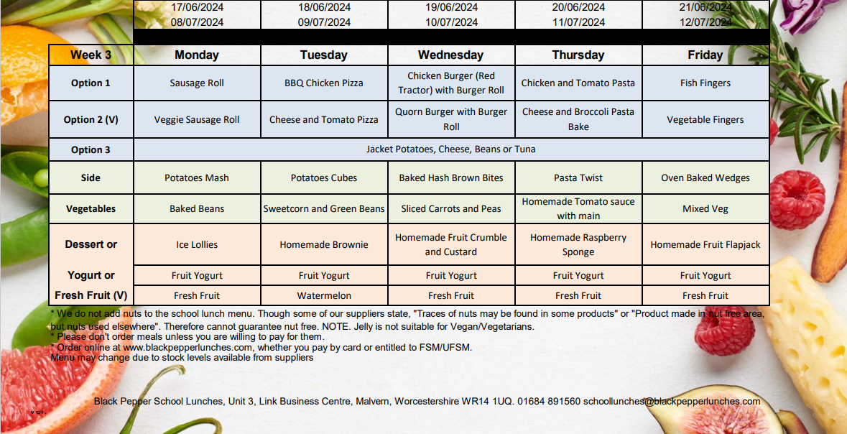
Example of a week of our menu

Slide 3
Registering & Ordering
Every child will need to be registered with us if you would like meals.
You can order online whether you are paying by card or entitled to free school meals. If you need to cancel or edit a meal you can also do this online.
You can order termly, weekly, or daily, with no minimum order, just make sure you order before midnight for the following day.
So how do you order?

Slide 4
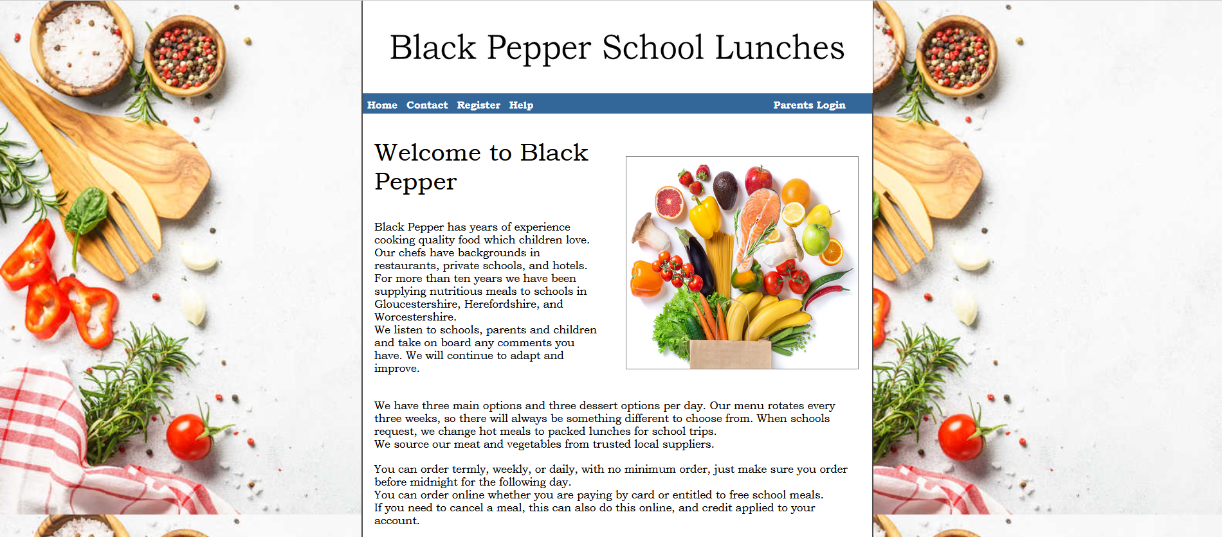
Firstly, go to Black Peppers Homepage
& Click ‘Register’

Slide 5
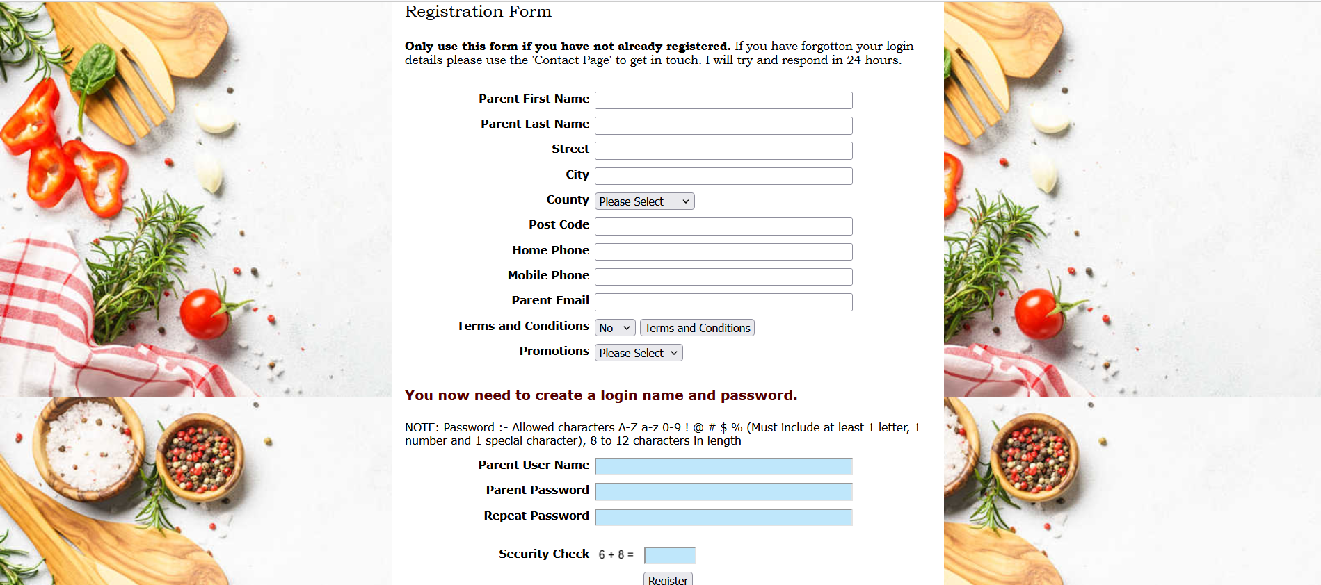
Fill in all your details and
Create a Username and Password

Slide 6
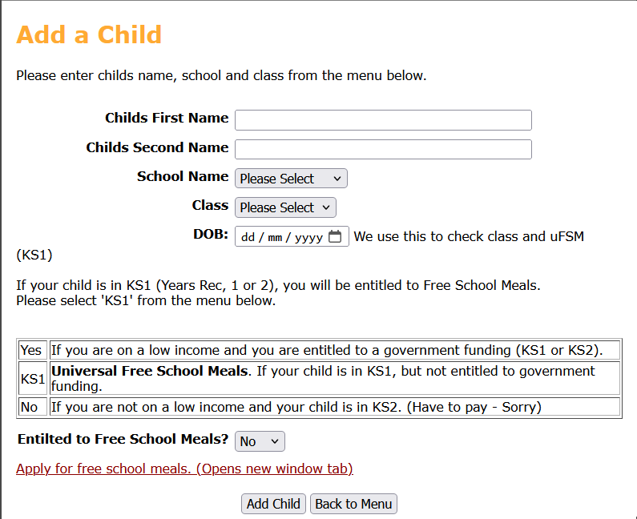
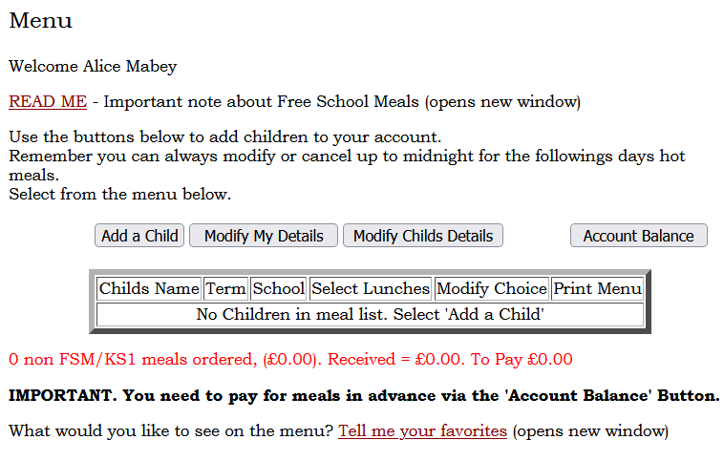
Click ‘Add a Child’ and then fill in their details
(this step can be repeated if you have more than one child)
Please remember to select whether you are entitled to Free School Meals

Slide 7
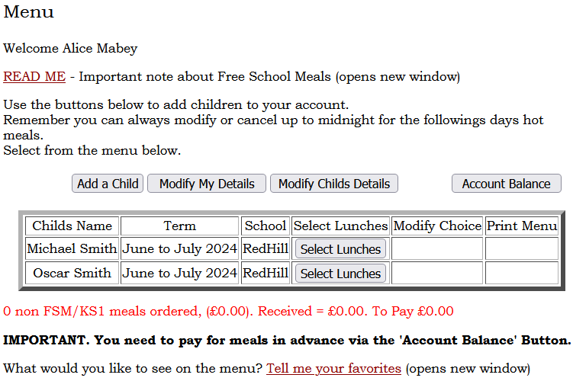
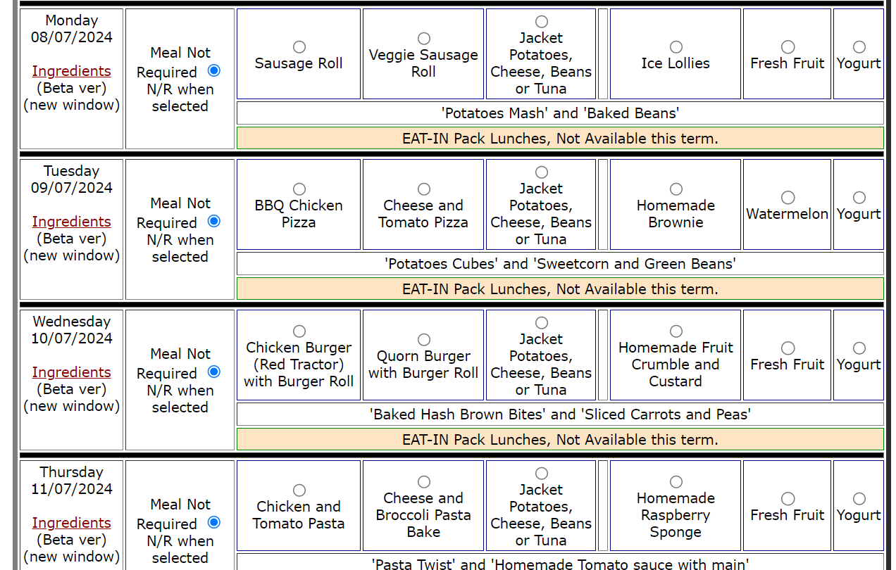
Click ‘Select Lunches’ and then make your choices!
Make sure your click ‘Save Details’

Slide 8
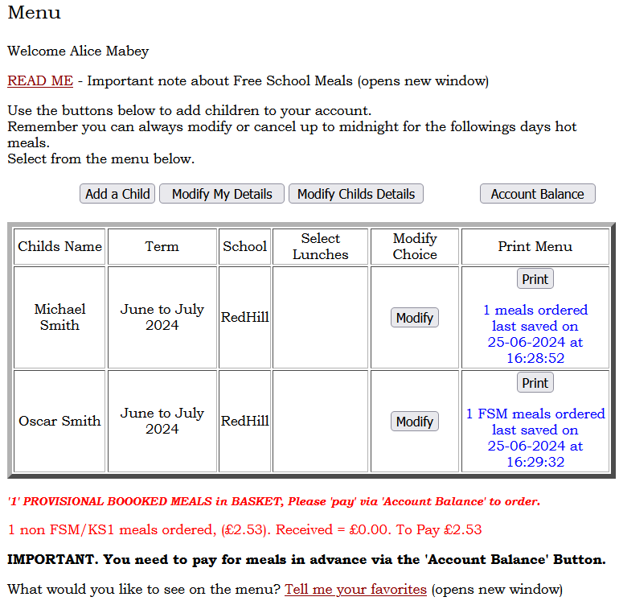
Paying for your meals
You can see the amount you owe at the bottom and then click ‘Account Balance’ and this will take you to the payment page.

Slide 9
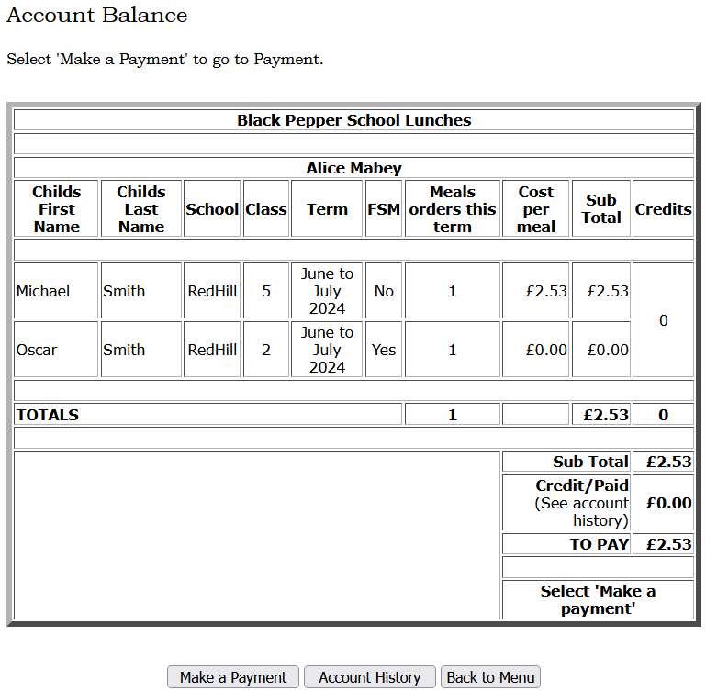
Paying for your meals
Click ‘Make a Payment’
This will then take you to a page to enter your card details. Once that’s completed you are all booked!

